Slide 1
ACCIDENT SEVERITY CODE PREDICTION
By Tejali Gangane

Slide 2
INDEX
1. INTRODUCTION
2. PROBLEM STATEMENT
3. ABOUT DATA
4. METHODOLOGY
5. VISUALIZATION
6. RESULTS
7. CONCLUSION

Slide 3
INTRODUCTION
Accidents occur daily. A traffic collision is also known as a car accident. Whenever a vehicle has collided with some object like a person, animal, road cones, building etc. an accident might occur. So many accidents are fatal. There are so many factors that are responsible for the accident to take place. It might be possible that the person who is driving the car was not paying attention, the person might be drunk while driving, the person was driving at a higher speed and was not able to get it under control when an object came near it or the traffic light didn’t work at a certain point for few seconds and 2 cars coming from different sides collided or improper roads, etc. People need to be aware and in a conscious state while driving the car, so as to avoid such accidents and the traffic systems also need to be monitored so as to ensure that such accidents do not happen.
There are different approaches used to monitor the traffic safety problems: reactive approach and proactive approach. In the reactive approach, the required improvements or changes are made to the variable that might act as a medium in an accident. Example, an unsafe work environment where the materials/instruments were not kept properly or in a safe place. Making sure that the instruments are kept in a proper way so that they do not harm anyone. Proactive approach, on the other hand, can include a collision prevention approach. Example, if a road is not in proper condition some kind of accident might take place. To avoid that, the access to that road itself will be blocked.
We mainly focus on the proactive approach, where certain calculations or estimations are already made to avoid any future accidents. The important factors in an accident are identified, it will be helpful to identify other similar potential accidents. And in this report, the word accident and collision are used interchangeably.

Slide 4
PROBLEN STATEMENT
How do accidents occur or what can be the possible reasons for an accident to occur? If an accident occurs, how will a person be able to identify the severity of the accident? Also, identify the factors responsible to understand how severe the accident actually is.

Slide 5
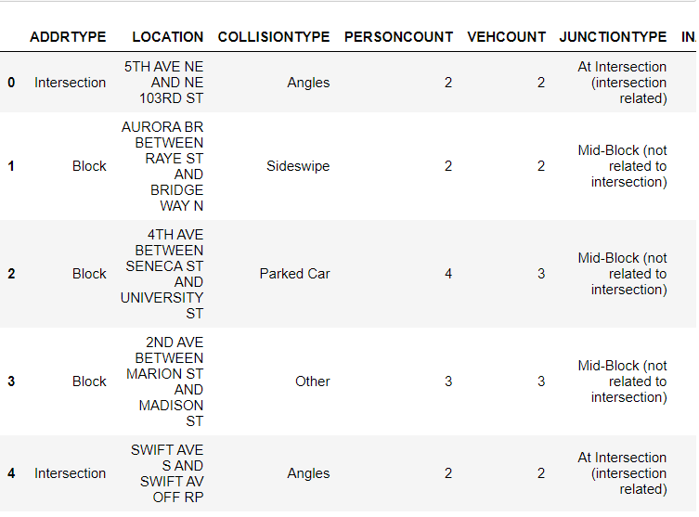
ABOUT DATA
The data set which will be used is the Data-Collisions provided through the Applied Data Science Capstone by Coursera. The data consists of the information about the accidents. The data has 194,673 rows and 38 columns. The columns are referred as the features of the dataset.

Slide 6
METHODOLOGY
SUPERVISED LEARNING:
It is the type of machine learning in which the models knows what type of data is to be predicted. There are certain input variables X and output variables Y and then we use an algorithm to learn the mapping function from the input to output. It was chosen because, our solution aims to predict the severity of the accident. For which there was a dataset present which consists of many features like total number of persons, what type of accident/collision was it, how many people were injured, the type of junction at which the accident took place. And also a feature for which the values are to be predict, is the severity code. It indicates how severe the accident is. The supervised learning can be further grouped into classification and regression.
CLASSIFICATION:
Classification a type of supervised learning was chosen because it will help in predicting a particular category. It is mostly used when our outcome is not a continuous value, but some particular value from certain set of values. Our solution aims to predict the severity code as mentioned before. These include: 3 – Fatality, 2b – Serious injury, 2 – Injury, 1 – Prop Damage, 0 – Unknown.

Slide 7
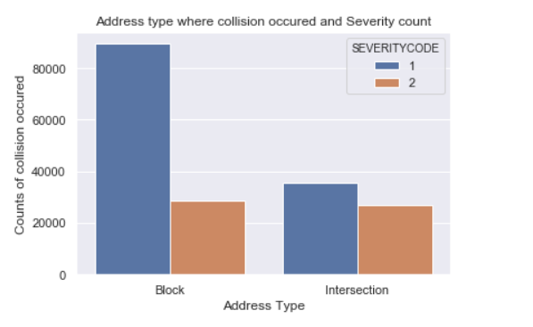
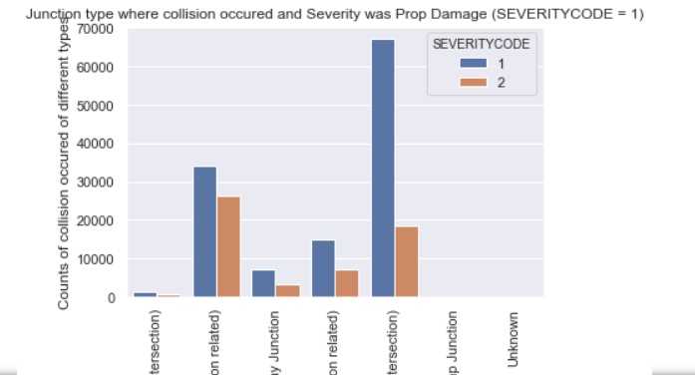
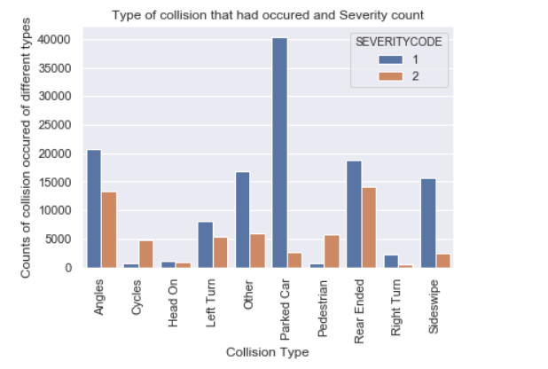
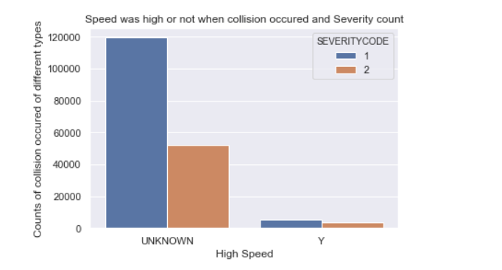
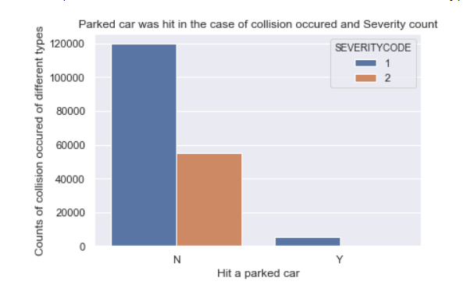
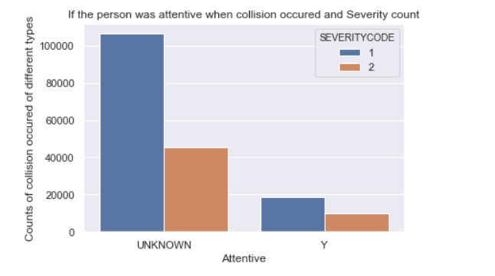
VISUALIZATION

Slide 8
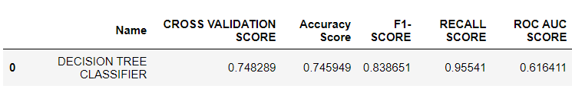
RESULTS
Decision tree classifier was chosen. And its hyperparameters were tuned. And after hyperparameter tuning, the scores were as follows:

Slide 9
CONCLUSION
More data is required for accurate classification. As some of the data was dropped due to missing values. If more data were to be present better results can be obtained. And better accuracy.

Slide 10
THANK YOU

